Slide 1
以 Spartan 建構分子
3-D 與 2-D 分子建構圖形介面操作

Slide 2
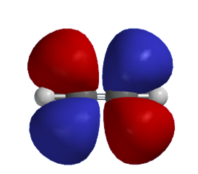
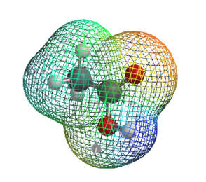
Using 3-D and 2-D modules to build molecules
Simple Molecules
H₂, H₂O, CH₃Cl, HCCH, CH₃COOH, C₆H₅OH
Advanced Examples
Acrylnitrile, Cyclohexanone, Limonene, Nicotin, Coumarin

Slide 3
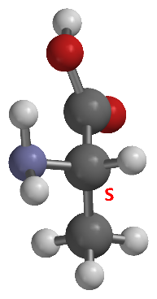
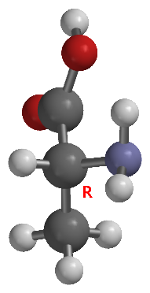
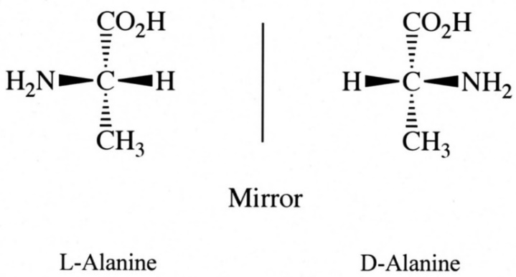
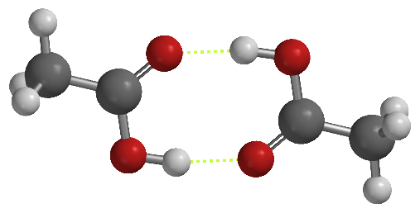
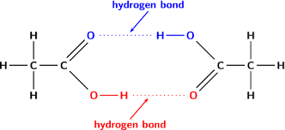
Molecules with optical activities
Ctrl + Double Click (change chirality)
Ctrl + Shift + Double Click (mirror image)
Dimers or Complexes

Slide 4
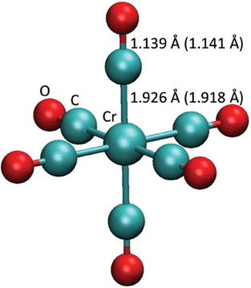
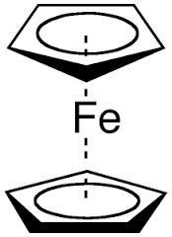
Using the 3-D module to build inorganic molecules
VSEPR: http://www.brainkart.com/article/Valence-Shell-Electron-Pair-Repulsion-(VSEPR)-theory_36437/
Simple Molecules
H₂SO₄, CS₂, BF₃, O₃, PCl₅
Examples:
Sulfur Tetrafluoride, Chromium hexacarbonyl, Ferrocene

Slide 5
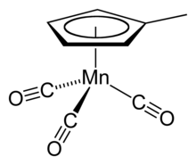
Using the 3-D module to build inorganic molecules
Spartan Exercises:
ClF₃, SO₃
XeF₄, ClO₄⁻
IF₅
trans- and cis-[Co(NH₃)₄Cl₂]⁺
Cr(H₂O)₄Cl₂

