Slide 1
基底函數 The Basis Set
影響計算準確度的關鍵因素
The crucial factor that determine the accuracy of the calculation

Slide 2
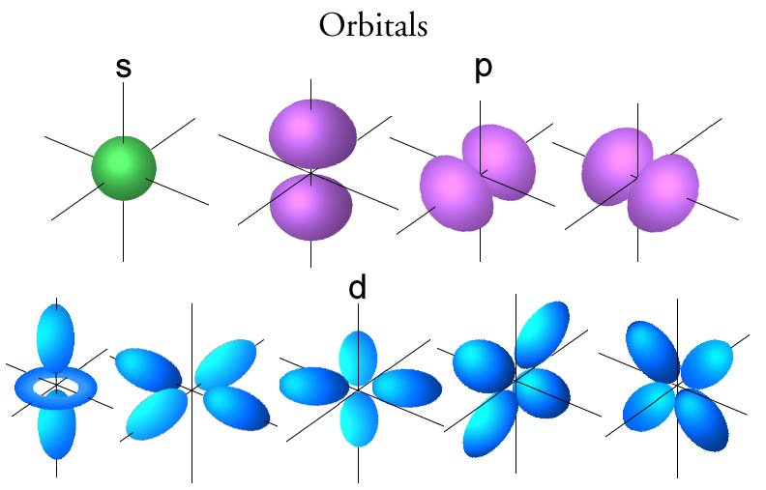
AO and MO MOs are linear combination of AOs LCAO-MO
hydrogen-like AOs：
Slater-Type Orbital (STO)
Gaussian-Type Orbital (GTO)
i + j + k
0 s-type (1)
1 p-type (3)
2 d-type (6)
3 f-type (10)
Cartesian Gaussian

Slide 3
Modern calculation uses GTO greatly simplifies the two-electron integrals
Contracted-Gaussian-Type Function (CGTF) uses LC-GTO to mimic STO
Basis Set all the AOs (CGTF) in a molecular calculation
Minimal Basis Set (STO-3G) the basis set that includes the same numbers and types of GTFs as the hydrogen-like orbitals (used in most chemistry courses)
g_{i} : primitive gaussians

Slide 4
Split-Valence Basis Set 兼顧準確度與計算效率 compromise between accuracy and efficiency
Valence Double-Zeta Basis Set Core：minimal basis Valence：two CGTF for an AO examples：3-21G, 6-31G (numbers show the primitive gaussians in CGTF)
Valence Triple-Zeta Basis Set Core：minimal basis Valence： three CGTF for an AO examples：6-311G，TZV，def2TZV

Slide 5
Polarization and Diffuse Functions for accurate calculation on the chemical bonding
polarization functions→ increase the angular moment of GTO first-period: adding p-type and higher GTOs second-period: adding d-type and higher GTOs examples:：6-31G(d,p) [6-31G**], 6-311G(3d2f,2pd) cc-pVDZ, cc-pVTZ
diffuse functions → extend the range of GTO (small Z) 6-31G(d,p) plus s, p → 6-31+G(d,p) cc-pVDZ plus s, p, d → aug-cc-pVDZ

Slide 6
Basis Sets Suggestions from rules to arts Theory/Basis Set
MP2, DFT : 6-31G(d) or larger
bonding changes for H atom：6-31G(d,p), cc-pVDZ
anions and hydrogen bonding：6-31+G(d,p), aug-cc-pVDZ
high-level theory: triple-zeta or larger: aug-cc-pVTZ, 6-311+G(3d2f,2pd)
The choices of basis sets are related to the properties of the system, accuracy and time requirements, computational resource available. The proper usage is an high art.

